Slide 1
Travel PLANNER agent
IBM AICTE PROJECT
Presented By: Subhadeep Sen
Student name : Subhadeep Sen
College Name & Department : RCC Institute Of Information Technology, Electronics and Communication Engineering

Slide 2
OUTLINE
Problem Statement
Technology used
Wow factor
End users
Result
Conclusion
Git-hub Link
Future scope
IBM Certifications

Slide 3
Problem Statement
A Travel Planner Agent is an AI-powered assistant that helps users plan trips efficiently and intelligently. It uses real-time data to suggest destinations, build itineraries, and recommend transport and accommodation options. By understanding user preferences, budgets, and constraints, it tailors personalized travel plans. Integrated with maps, weather updates, and local guides, it ensures a smooth travel experience. The agent can also manage bookings, alert users to changes, and optimize schedules on the go. This smart assistant transforms complex travel planning into a seamless, enjoyable process.

Slide 4
Technology used
IBM cloud lite services
Natural Language Processing (NLP)
Retrieval Augmented Generation (RAG)
IBM Granite model

Slide 5
IBM cloud services used
IBM Cloud Watsonx AI Studio
IBM Cloud Watsonx AI runtime
IBM Cloud Agent Lab
IBM Granite foundation model
IBM AI Tools
IBM Cloud Object Storage

Slide 6
Wow factors
A Travel Planner Agent is an AI-powered assistant that helps users plan trips efficiently and intelligently. It uses real-time data to suggest destinations, build itineraries, and recommend transport and accommodation options.
Unique features:
AI-Powered Personalized Trips
Suggests itineraries tailored to user preferences, budget, and travel style.
Automatically updates plans with live flight, train, and weather data.
Suggests best travel dates, low-cost booking windows, and peak season avoidance.
Automatically finds the shortest routes, best offers, and combo deals

Slide 7
End users
Academic Researchers
Research Institutions and Universities
Individual Travellers
Travel agencies
Business executives

Slide 8
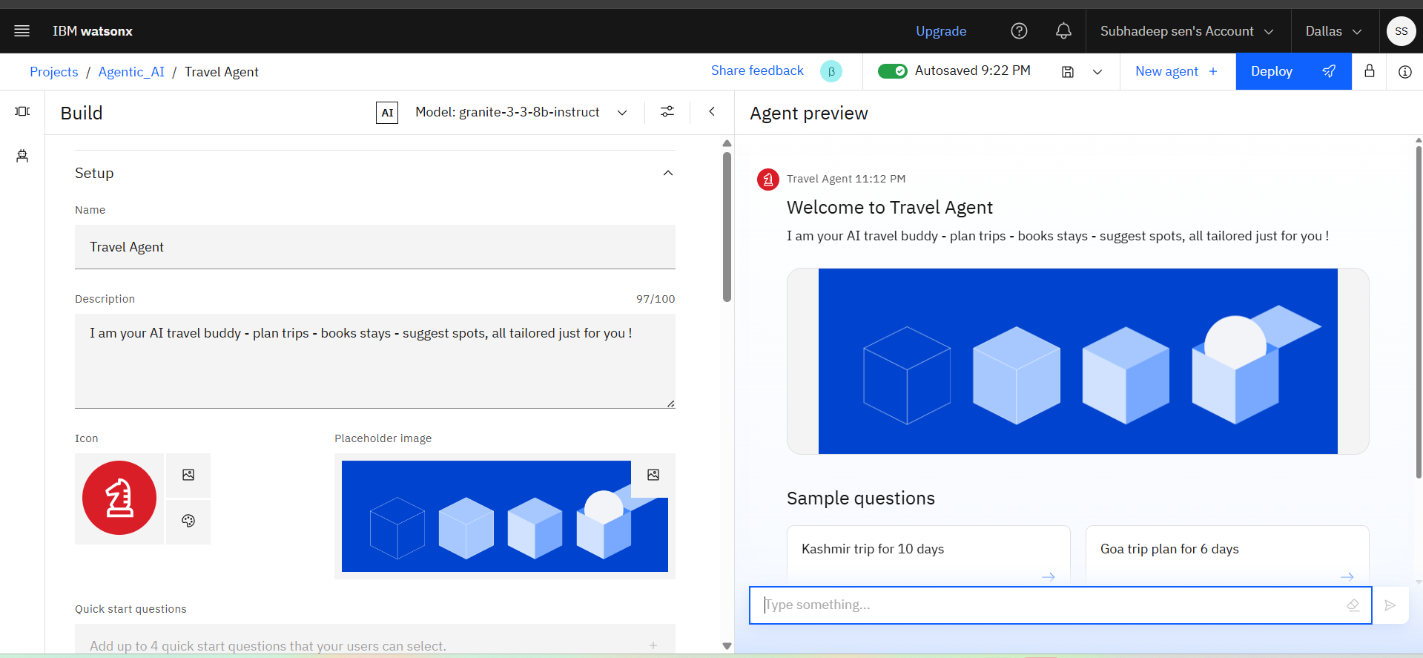
Results

Slide 9
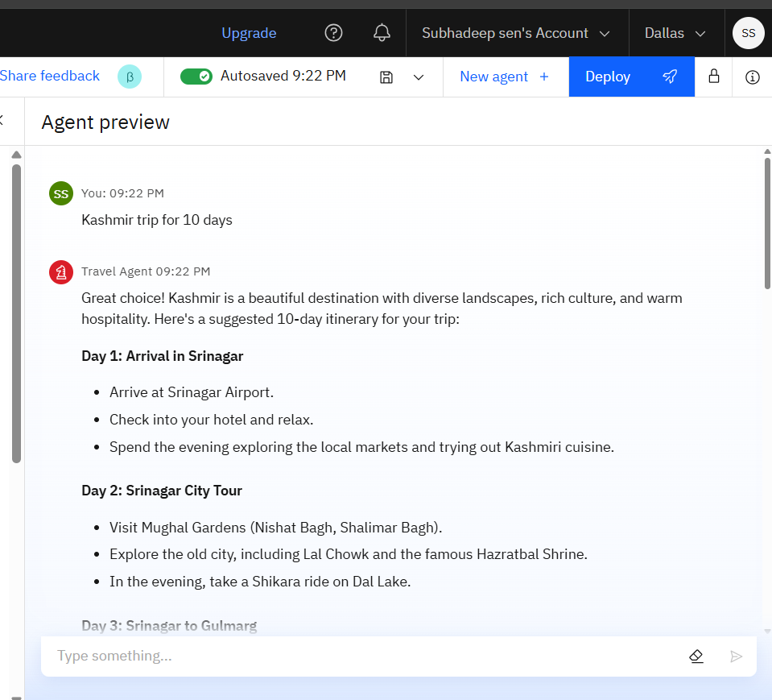
Results

Slide 10
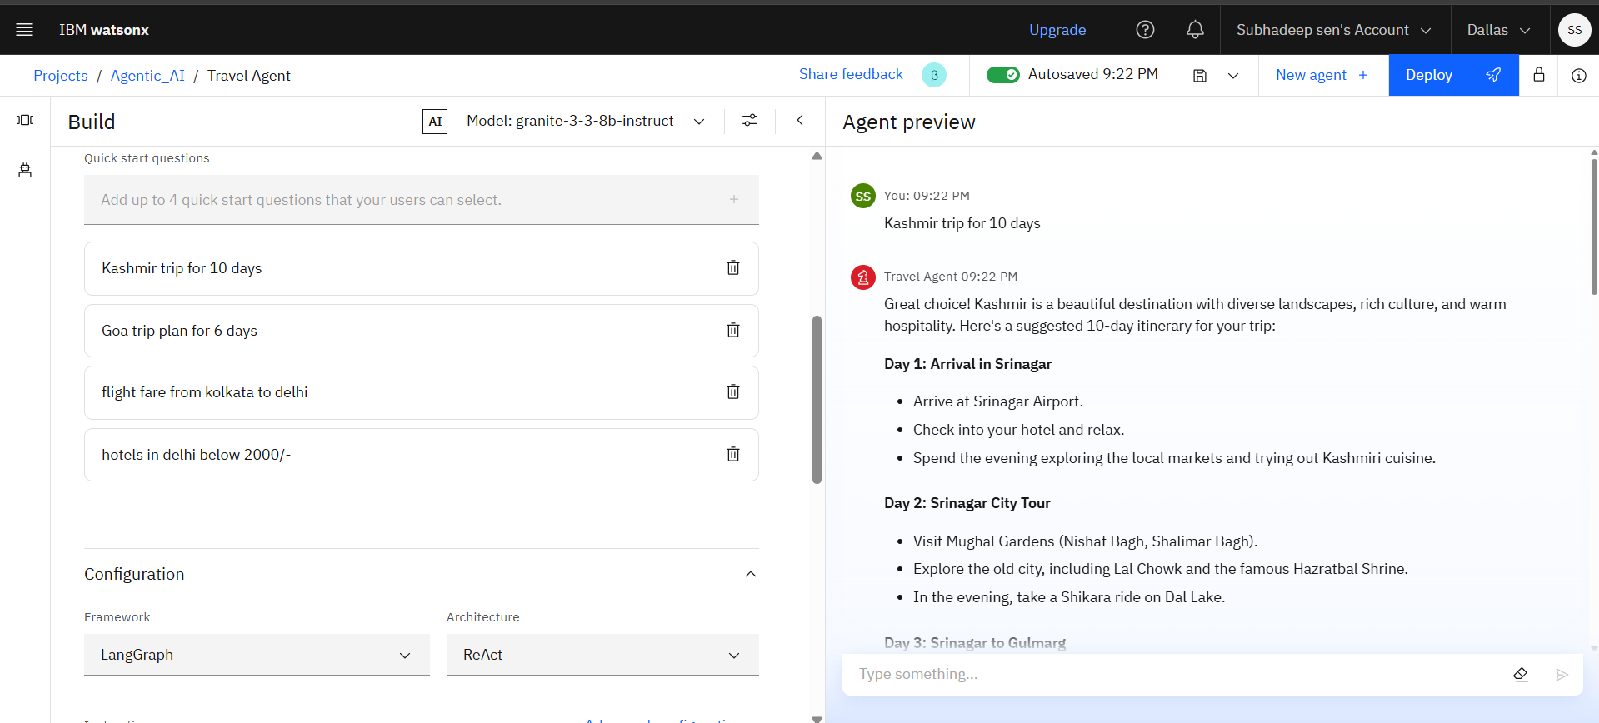
Results 4 quick questions

Slide 11
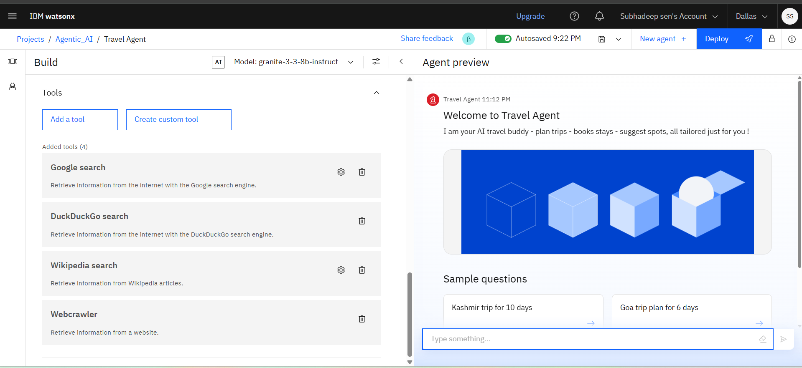
Results used tools

Slide 12
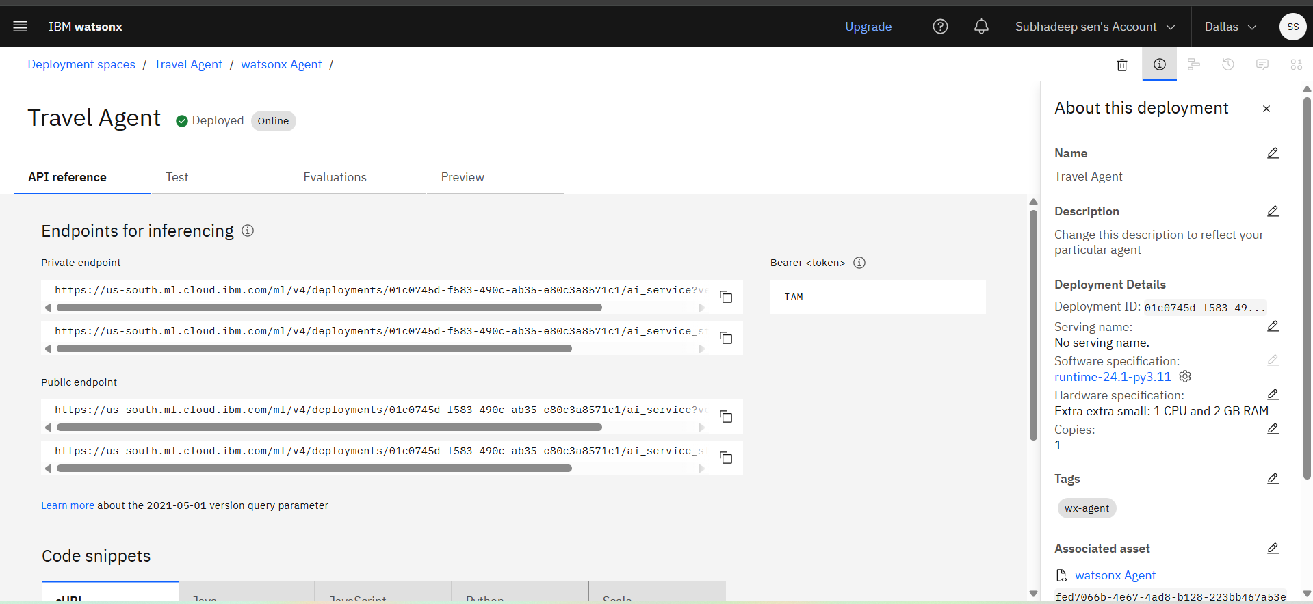
Results API reference

Slide 13
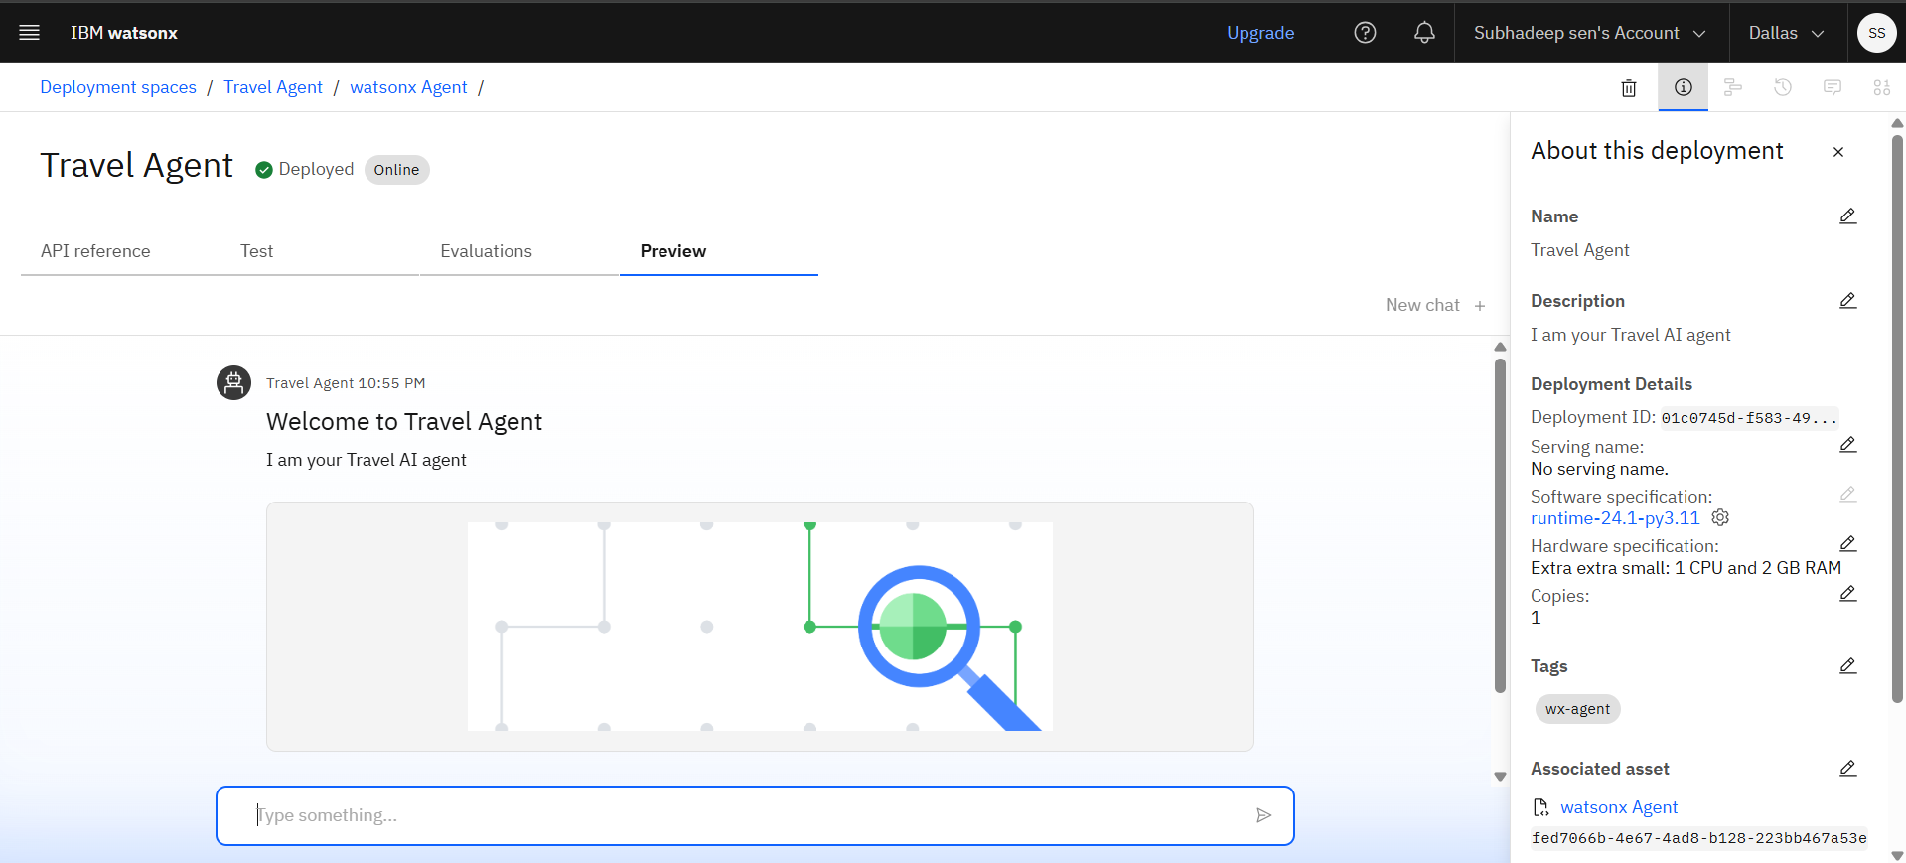
Results
Deployed AI Agent

Slide 14
Conclusion
The AI-based Travel Planner Agent revolutionizes the way we plan journeys by combining personalization, real-time intelligence, and automation. By seamlessly integrating itinerary creation, live updates, and smart recommendations, it transforms complex travel planning into a stress-free, efficient, and enjoyable experience. This innovation not only saves time and optimizes costs but also enhances the overall travel experience, making it the ultimate companion for modern travelers.

Slide 15
Future scope
Enable hands-free travel planning using voice commands and AR-based virtual guides.
Provide travel assistance in multiple languages for global accessibility.
Use AI to auto-generate complete travel plans based on minimal user input.
Predict future ticket/hotel prices and suggest the cheapest booking window.
Allow group planning, real-time sharing, and synchronized itineraries with friends/family.
Recommend eco-friendly transport, stays, and activities to support green travel initiatives.

Slide 16
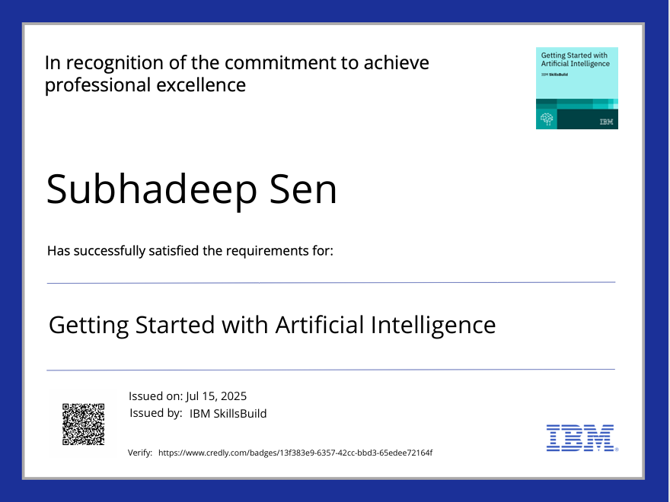
IBM Certifications

Slide 17

IBM Certifications

Slide 18
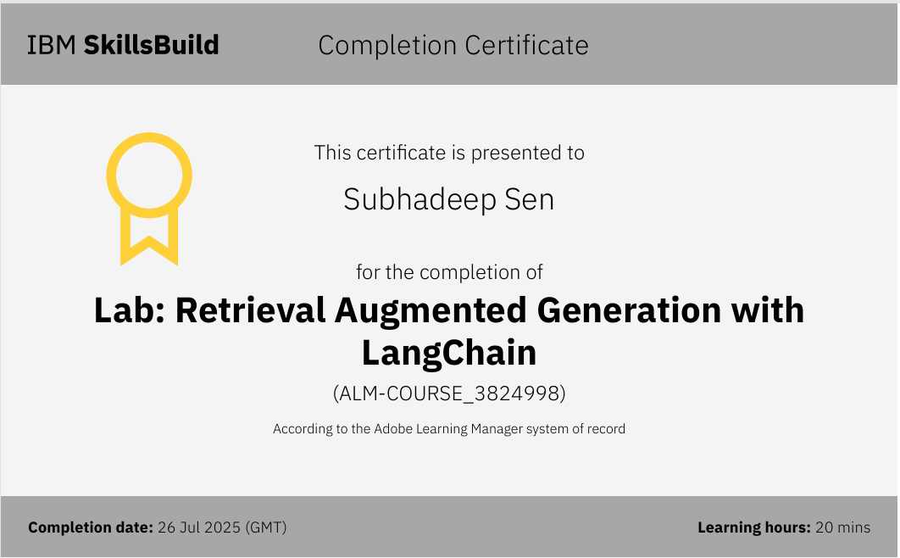
IBM Certifications

Slide 19
THANK YOU

